Slide 1

Online Voting System in C++
A mini Project
Presented by: Priyanshu [ 12217918 ] and Harsh devliyal [ 12220933 ]
Roll no.:- 56 and 55

Slide 2
Online Voting System in C++ - Overview
This slide introduces a basic online voting system in C++. It uses memory for data storage and skips authentication for simplicity.
System Functionality
Programming Language
Data Management
User Access
A simple online voting system designed for easy elections. Voters can select candidates and submit votes via a command-line interface.
Vote data is stored in memory during the program's run. This avoids file handling or databases, but data is lost when the program closes.
The system skips login for ease of use. Voters can immediately participate without accounts or passwords. This is for demonstration; real systems need strong authentication.
Built in C++, showcasing the language's ability to create efficient, interactive systems. Code is designed to be clear and easy to modify.

Slide 3

Key Features of the Online Voting System
Candidate Management
Secure Voting Process
Real-time Results Display
Administrators can add, remove, and update candidate information, including names, positions, and photos, through a secure interface.
Voters can cast their ballots for their preferred candidates. The system ensures that each voter can only vote once, preventing fraud and ensuring fair results.
The system provides an interface for displaying the current voting results. Results are updated in real-time as votes are cast, maintaining transparency.
All voting data is stored temporarily in memory for fast access but will be lost when the system shuts down.

Slide 4
Key Concepts Used
Arrays
Loops
Functions
Arrays are used to store and manage collections of candidates and voters, allowing for efficient data access and manipulation during the voting process. For instance, an array stores the names of all candidates.
Loops iterate through arrays of candidates and voters for repetitive tasks such as displaying candidate lists, counting votes, and checking voter eligibility. Useful for tallying votes.
Functions break down the program into smaller, reusable modules, promoting better organization and maintainability of the codebase. Each function can carry out smaller components of tasks.
Strings
Conditional Statements
Strings store textual information such as candidate names, voter usernames, and other descriptive details, essential for displaying information and processing user input.
Conditional statements control program flow based on specific conditions, such as verifying voter eligibility, checking for duplicate votes, and validating user inputs.

Slide 5

Admin Panel
Add New Candidate
View All Candidates
Maximum of 100 candidates.
See the list of all candidates.
Show Voting Results
Data Storage
Display the current voting status.
Uses arrays to store names and vote counts.

Slide 6
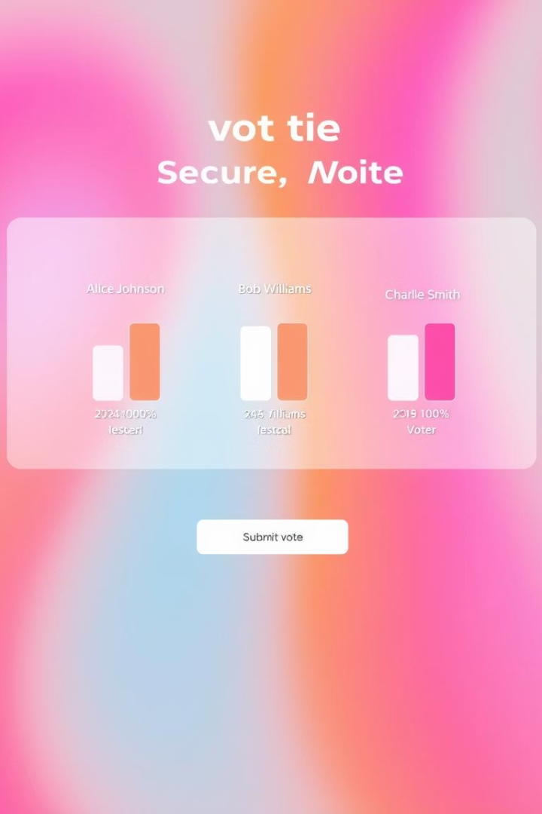


Voter Panel
User Authentication
Steps for user authentication and eligibility check:
User enters their name
System checks if already voted
Candidate Selection
Steps for voting and preventing duplicate votes:
Lists all candidates
Increments vote count for selected candidate
Adds user to votedUsers list

Slide 7


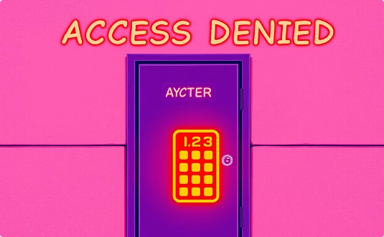
How Duplicate Voting is Prevented
User Identification
Voter Registry
Duplicate Vote Prevention
Each user is identified with a unique identifier to ensure only one vote per person.
The system checks against a secure registry of voters to prevent duplicate submissions.
If a user is found in the registry, voting is denied to maintain election integrity.

Slide 8

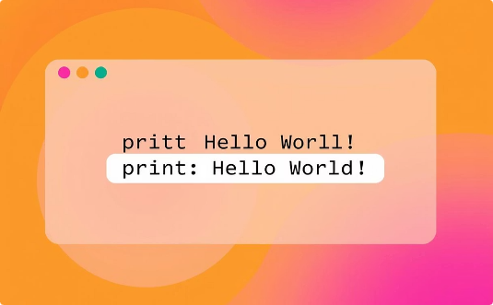

No File Handling
No Data Saved
Simple Implementation
Ideal for Demos
Data is not saved after the program closes.
Easy to implement and test.
Well-suited for demos or beginner-level projects.

Slide 9
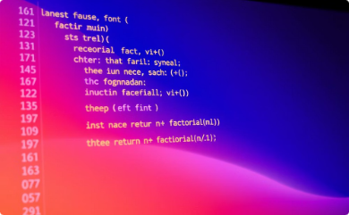
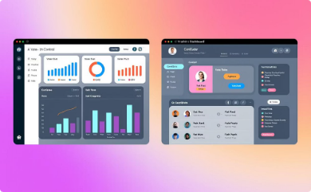


Advantages
Beginner-Friendly
Clear Separation
Multiple Voting Prevention
Easy to Extend
Easy to understand C++ project.
Distinct admin and voter logic.
Easily add features like winner display.
Prevents multiple voting effectively.

Slide 10


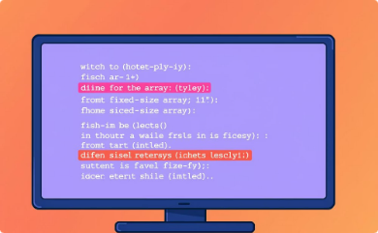
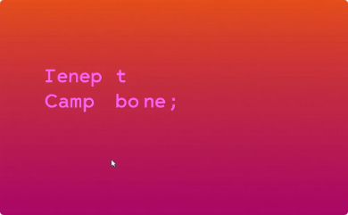
Limitations
No Data Persistence
No Password Protection
Fixed Array Sizes
Console-Based Only
Resets on close, no data saved.
Limited storage capacity.
No graphical interface.
Admin panel lacks security.

Slide 11
Possible Improvements
Data Persistence
Admin Login
Graphical Interface
Save data after program closes.
Add security to the admin panel.
Develop a user-friendly GUI.
Winner Display
Real-Time Results
Announce the election winner.
Show live vote percentages.

Slide 12

Thank You!

